Slide 1
2x5 Element Arrays
09DE19

Slide 2
Details
2x 5 element arrays
“Tx” array has ports 1-5 and located at global coordinate system origin
“Rx” array has ports 6-10
Simulation frequencies
20-500M, step 20M
500M-1G, step 50M
1-6G, step 50M
Exported data
10x10 S matrix
Note: All data at theta 90 so all data is at theta 90 vs phi
Note: there are redundant phi angles at -180° and +180°, so you have 361 phi angles. Not sure which to delete so left it in.

Slide 3
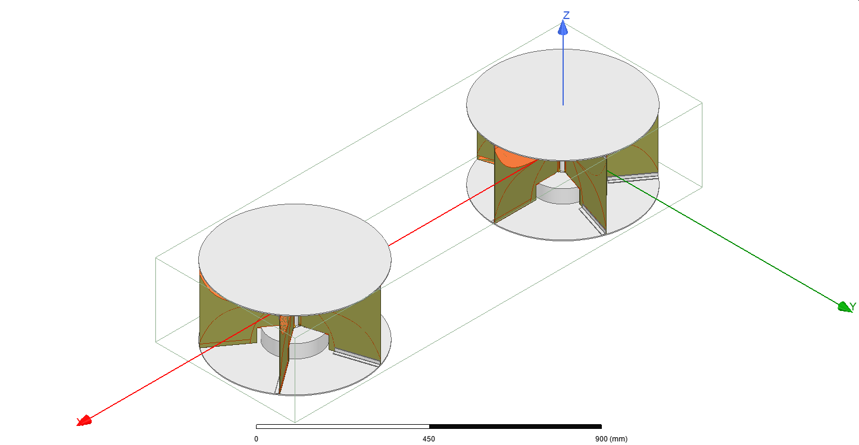
2x 5 element arrays
“Tx”
Ports 1-5
“Rx”
Ports 6-10

Slide 4
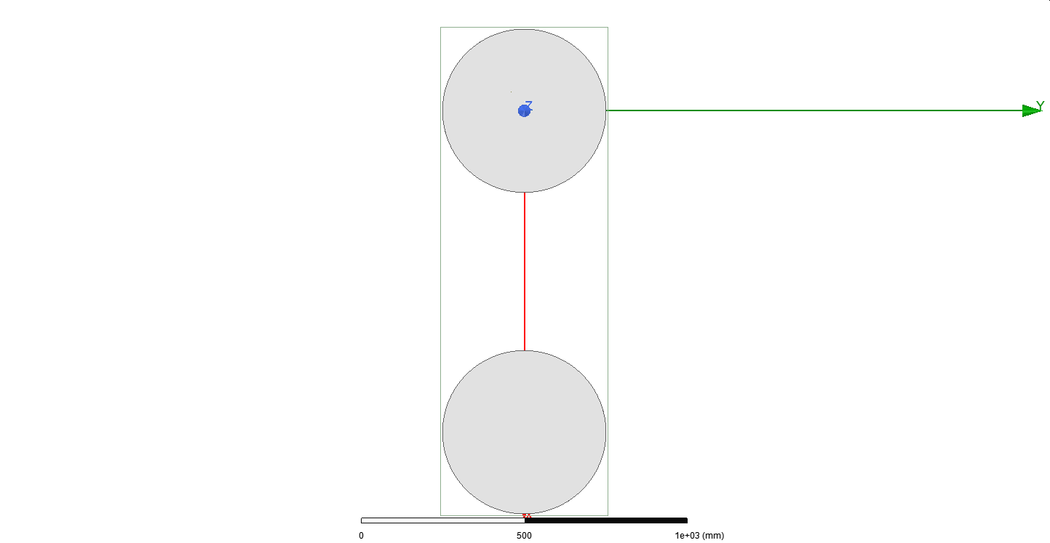
Top View

Slide 5
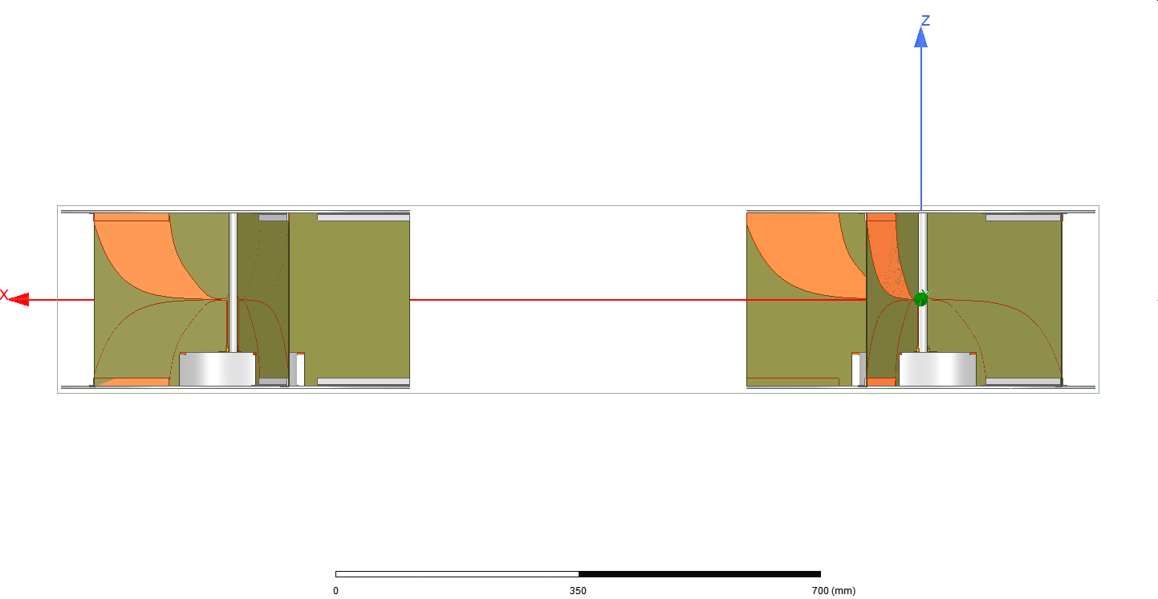
Side View

Slide 6
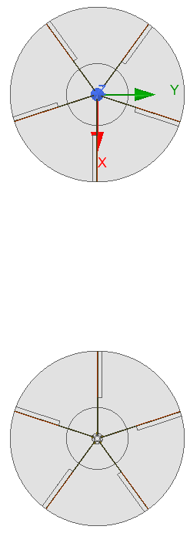
3
4
Port numbering and array separation
“Tx”
2
5
1
1m
6
10
7
“Rx”
9
8

Slide 7
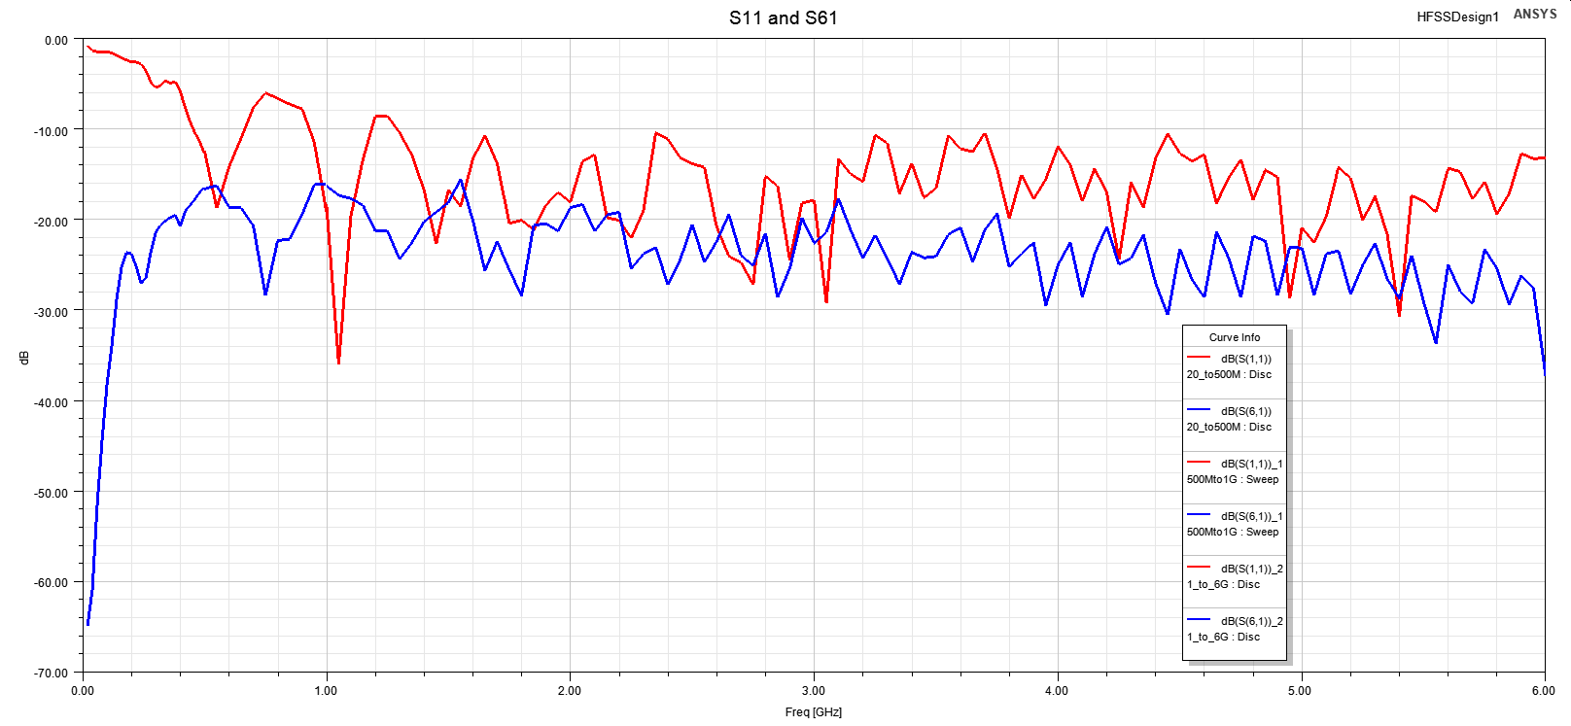
S Parameters Red = S11, Blue = S61

